Slide 1
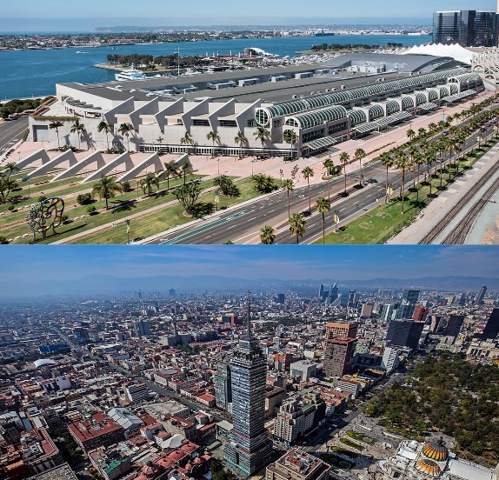

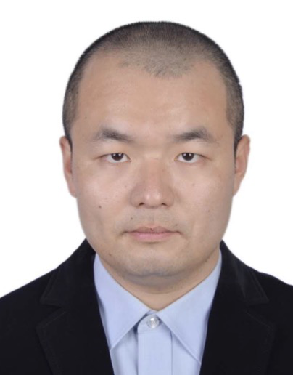



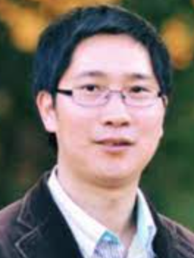
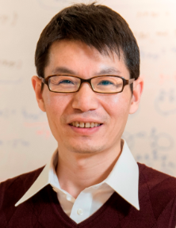



NeurIPS 2025
Towards a Geometric Understanding of
Tensor Learning via the t-Product
Andong Wang
RIKEN AIP
Yuning Qiu
RIKEN AIP
Haonan Huang
RIKEN AIP
Zhong Jin
CUPK
Guoxu Zhou
GDUT
Qibin Zhao
RIKEN AIP

Slide 2
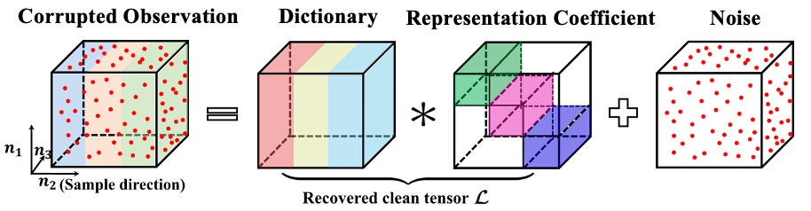




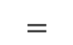

Motivation: Why Do We Need a Geometry Framework for t-Product?
T-Product-based Low-rank Representation^{[1]}
🪫 Limitations of TLRR
📊 T-Product-based Low-Rank Representation (TLRR)^{[1]} outperforms vectorized LRR^{[2]} in clustering and recovery
⛔️ But its subspace-based assumption makes it intrinsically linear
➔ limited in modeling nonlinear geometry
T-product Algebra ^{[3]}:
t-Product Between t-Scalars
discrete t-scalar^{[3]} :
a vector
🪫 Incompatibility of Classical Differential Geometry
Classical geometry is over real/complex fields, but t-product algebra ^{[3]} is over the t-scalar ring, where each t-scalar is a vector ^{[3]} or function ^{[4]}
➔ classical differential geometry is not directly compatible with t-scalar
$$a$$
$$∗$$
$$b$$
$$=$$
$$c$$
continuous t-scalar^{[4]} :
a function
motivate
💡 Two Questions
Q1: Can we establish a differential geometric framework that unifies discrete and continuous t-scalars?
Q2: Can such a framework support the theory of learning on low-dimensional t-manifolds from tensor data?
[1] Zhou, P., et. al. Tensor low-rank representation for data recovery and clustering. IEEE PAMI, 2019.
[2] Liu, G., et. al. Robust recovery of subspace structures by low-rank representation. IEEE PAMI, 2012.
[3] Kilmer, M. E., et. al. Third-order tensors as operators on matrices: A theoretical and computational framework with applications in imaging. SIAM Journal on Matrix Analysis and Applications, 2013.
[4] Wang, C., et. al. Functional tensor singular value decomposition. SIAM Journal on Scientific Computing, 2025.

Slide 3
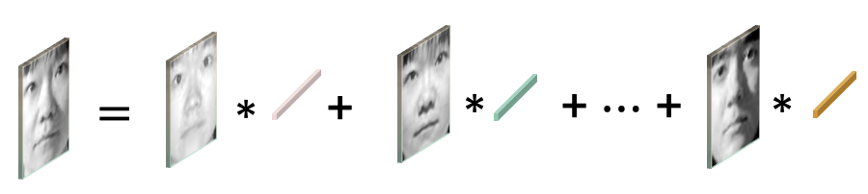



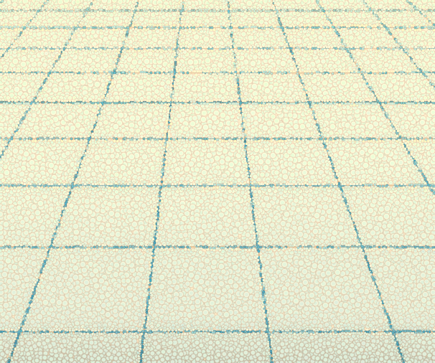
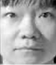
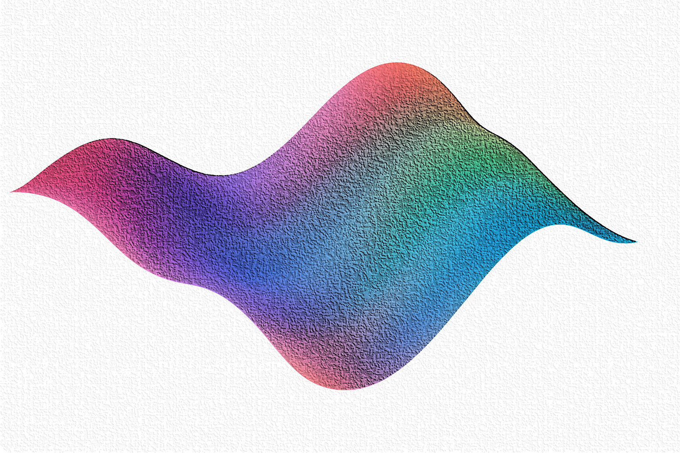
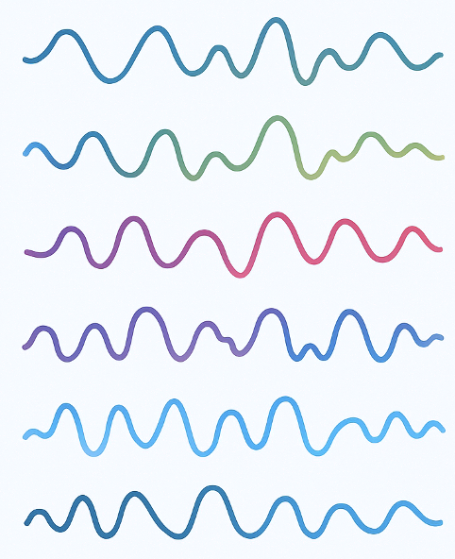
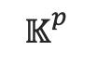
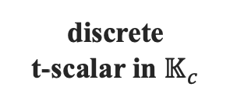
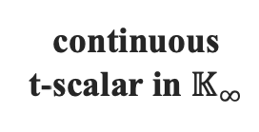
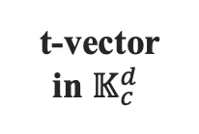

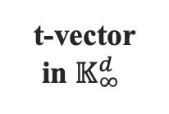
Contribution: A t-Product Geometry
A t-module can be seen as a
t-linear space
(I)
(E)
$$⋮$$
Sliced smooth manifolds in the transform domain
t-module
$𝕂_{}^{p}$
(C)
(G)
(A)
discrete
t-scalar in $𝕂_{c}$
Support
t-vector
in $𝕂_{c}^{d}$
Local homeomorphism
Decompose
form
(H)
hypothesis testing of t-manifold
form
(D)
t-manifold fitting from noisy data
(B)
t-vector
in $𝕂_{∞}^{d}$
function learning on t-manifold
continuous
t-scalar in $𝕂_{∞}$
t-manifold
(F)
Learning theory on t-manifolds
Logic of the Framework: From t-Scalars → t-Vectors → t-Modules → t-Manifolds → Learning Theory
A–B: t-scalars — discrete or continuous (vector/function “scalars”).
C–D: t-vectors formed from t-scalars.
E: t-module = t-linear space.
G–F: local homeomorphism ⇒ t-manifold (smooth space over t-scalars).
I: decomposed into frequency-wise sliced manifolds.
H: supports learning theory — testing, fitting, function learning.
Notes:
Let me walk you through the logic of this framework from A to H.
We start from the basic algebraic units. (A) shows a discrete t-scalar in $𝕂_{c}$, and (B) extends it to a continuous t-scalar in $𝕂_{∞}$. Each t-scalar is not a number but a vector or function that acts like a scalar under the t-product.
From these elements, we can form t-vectors, shown in (C) and (D), living in $𝕂_{c}^{d}$or $𝕂_{∞}^{d}$.
When such t-vectors span a linear space under the t-product, we obtain a t-module, shown in (E) — the t-analogue of a vector space.
Now, moving to (G), the key geometric idea: each small region of a t-manifold is locally homeomorphic to a t-module. That is, around any point on the manifold, we can find a local chart that behaves like a t-linear space.
This gives rise to the t-manifold itself, shown in (F) — a smooth geometric object defined over the t-scalar ring.
In the transform domain, the t-manifold can be decomposed into multiple frequency-wise sliced manifolds, as shown in (I). Each slice describes smooth geometry at a specific frequency.
Finally, these constructions support the learning theory in (H): testing whether data lie near a t-manifold, fitting a t-manifold from noisy samples, and learning smooth functions defined on it.
So overall, the logic flows from t-scalars → t-vectors → t-modules → (G) local homeomorphism → t-manifolds → spectral decomposition → learning theory.

Slide 4


Answering Q1 & Q2 — Geometry and Learning on t-Manifolds
Splitting Q1: Geometry Building over t-Scalars
Q1.1 How to define t-manifolds?
→ t-modules as local spaces, where coordinates are t-scalars.
→ t-manifold is a smooth space locally homeo. to t-modules.
Q1.2 How to define smoothness and differentiation?
→ Define 𝕂-smooth functions that are slice-wisely smooth in the transform domain.
→ Organize them using a structure sheaf, allowing us to define tangent derivations and differential forms consistent with the t-product algebra.
Q1.3 How to measure and connect geometric quantities?
→ Define 𝕂-valued Riemannian metrics
→ Then define gradients, Laplacians, and geodesics that respect both algebraic and geometric structure.
Splitting Q2: Learning on t-Manifolds
Q2.1 Does a t-manifold structure exist, and can we test it?
We extend the manifold hypothesis^{[5]} to t-product spaces.
→ Each frequency slice forms a smooth manifold; together they define a global t-manifold.
→ A t-manifold hypothesis test then decides whether observed tensor data lie close to such a structure.
Q2.2 If it exists, can we reconstruct it?
Yes — a t-manifold fitting theorem shows we can recover a t-manifold from noisy samples with provable accuracy.
Q2.3 Can we learn smooth functions on t-manifolds?
We use Tensor Neural Networks to learn 𝕂-smooth functions on t-manifolds while preserving both geometry and algebraic structure.
🔑 Modeling Potential
We illustrate modeling potential of integrating geometric information into t-product algebra by a bidirectional tensor representation that enhances clustering and data recovery.
OpenReview
GitHub
[5] Fefferman, C. et. al. Testing the manifold hypothesis. Journal of the American Mathematical Society, 2016.

